Slide 1
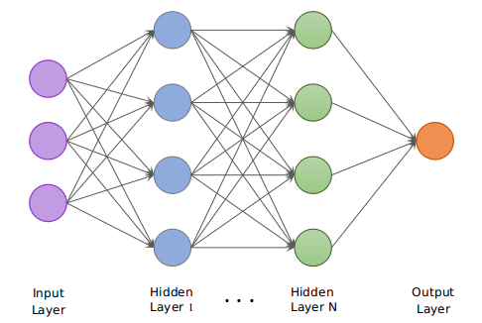
Image - super resolution
Using deep convolutional network.

Slide 2
Team members
Janna Allah Ayman
Sief El-Deen
Tarek Magdy
Amr Shabaan
Mohamed Saad
Adham Tarek
Abdelrahman Mohamed

Slide 3
Supervisors
Prof. Dr. Hafez Abd-elWahab
T.A. Fatma Refaat
T.A. Dawood Essam
T.A. Antonio Garas

Slide 4
Agenda
Introduction
Applications
Background
Motivation
Objective
Problem Statement
Problem Solution
Planning

Slide 5
Agenda
Literature review
Interpolation based SISR
DL techniques of SISR
Lightweight techniques of SISR
Results
Measures of Quality image
Methodology
Dataset
Tools

Slide 6
Introduction

Slide 7


Introduction
Image super-resolution (SR) is one of the vital image processing methods that improve the resolution of an image in the field of computer vision.
Low resolution
High resolution

Slide 8
Introduction
Super resolution plays an important role in several fields such as:
Computer graphics
Medical imaging
Security
Space
Satellite

Slide 9
Applications

Slide 10
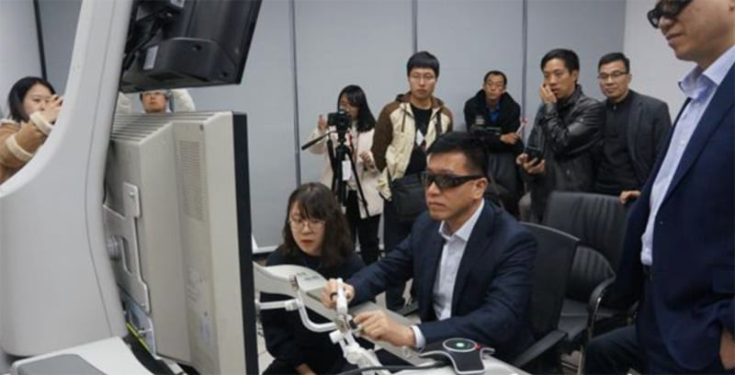
Applications
Medical and surgery industry:
5G is being used to perform remote surgery from thousands of miles away, and it could transform the healthcare industry.
Huawei ariticle 2019

Slide 11
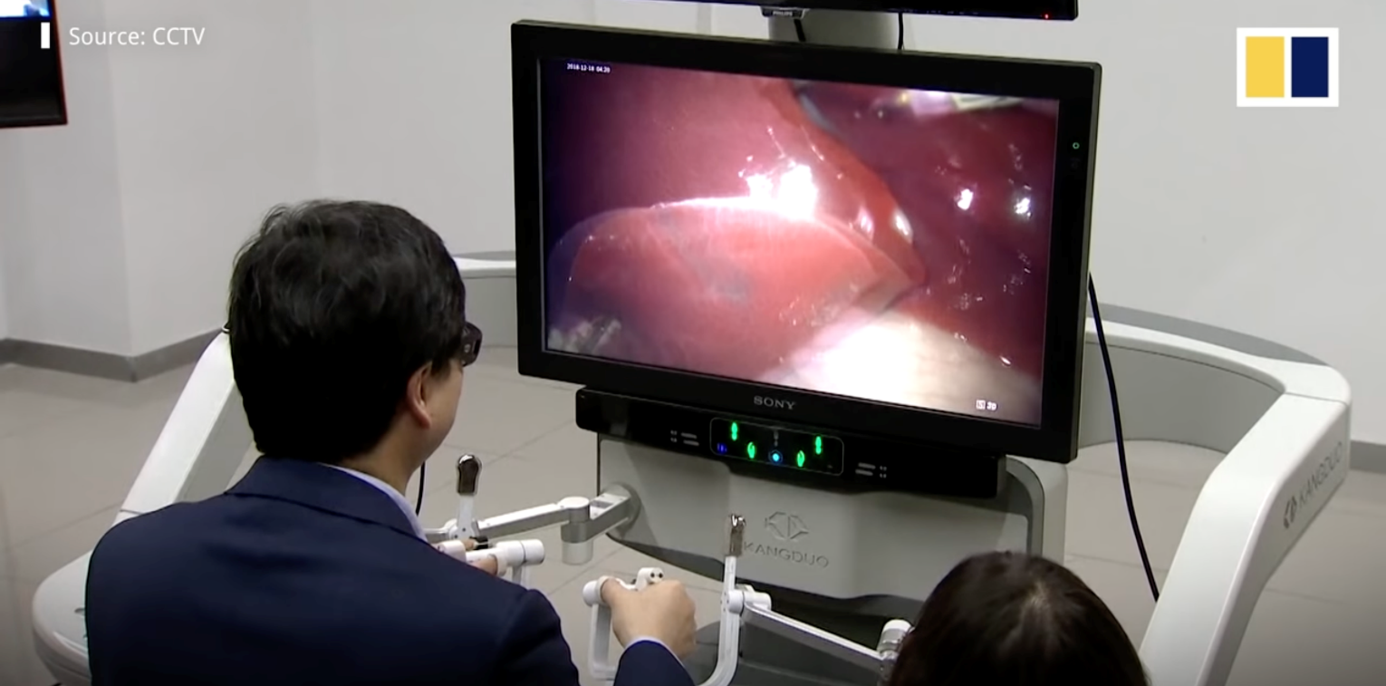


Applications
Surgery:
In basic room using stimulation device and high computer specifications , good 8K display + Using super resolution system for get super resolution image when doctor need better image .
And that help doctors to look carefully and choosing the right decisions.
Huawei ariticle 2019

Slide 12
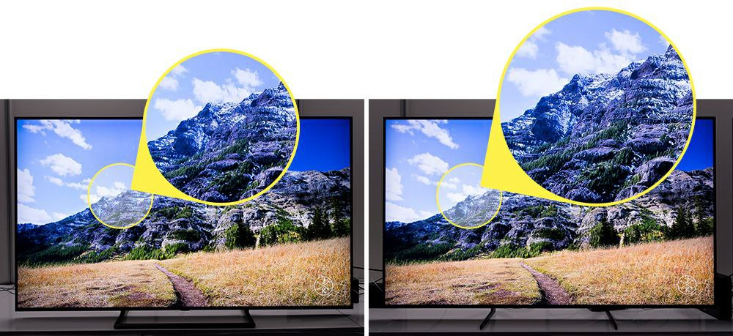

Applications
Using 8K display:
And it include processor for make AI upscaling:
(4K) (8K upscaled)
Samsung Newsroom article 8K AI Upscaling
November 14, 2018

Slide 13
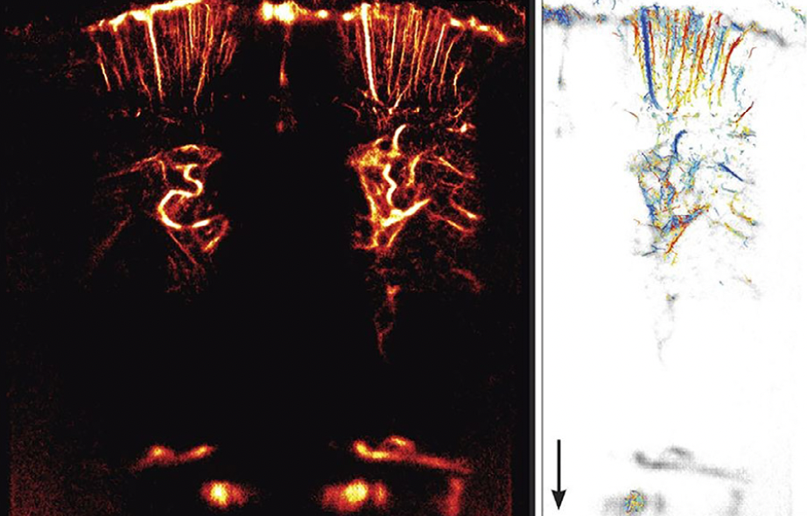
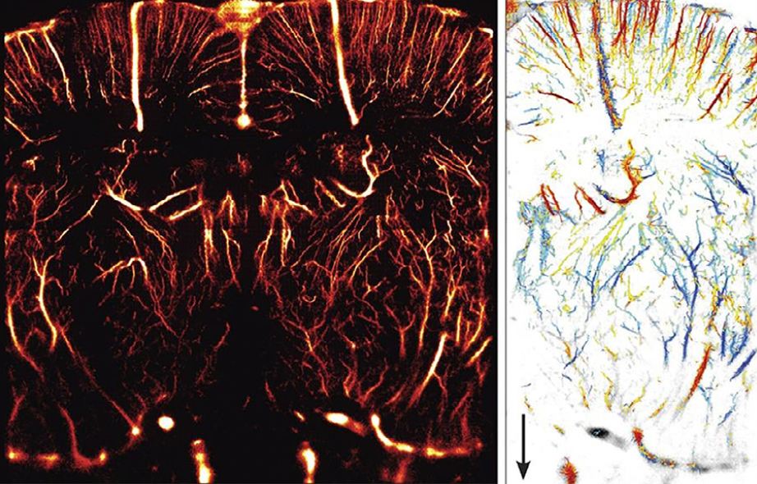
Applications
Ultrasound using GAN:
SUPER-RESOLUTION ULTRASOUND IMAGING-2019

Slide 14


Applications
Detect criminals for government:

Slide 15
Background

Slide 16

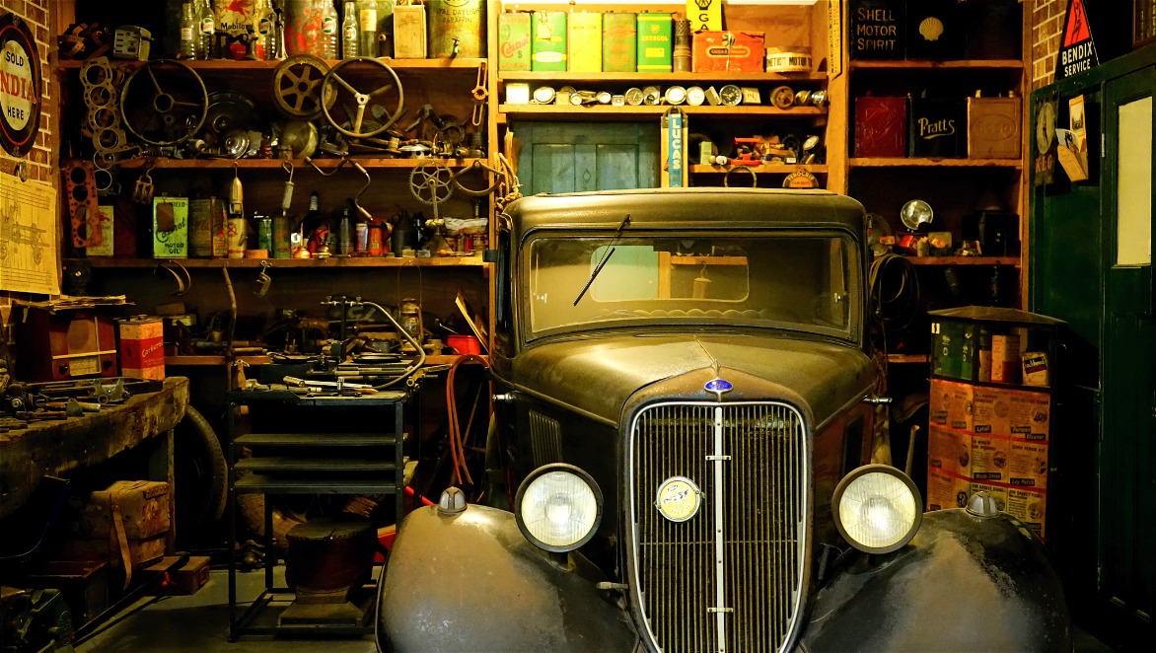
Background
The concept of super-resolution (SR) is defined as the method of producing high-resolution (HR) image from a corresponding low-resolution (LR) image.
Low resolution
High resolution

Slide 17

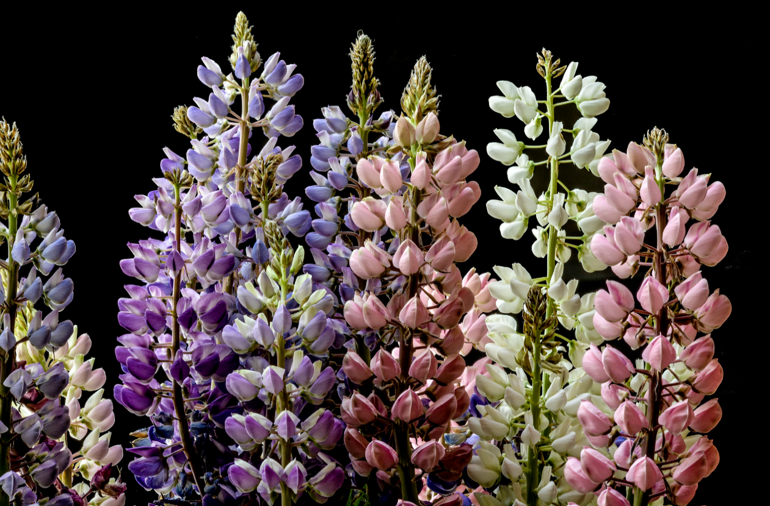
Background
Image resolution describes the details contained in an image, the higher the resolution, the more image details.
Low resolution
High resolution

Slide 18

Background
Super resolution should fix all of the problems in the image ex. noise, blurring, etc. …
Low resolution
High resolution

Slide 19
Motivation

Slide 20
Motivation
As mentioned before, super resolution is important and have many applications.
As Time keeps going the image resolution is also increasing so we need to cope up with the changes , the older programs for enhancing the image is getting old.
As well as the need of high quality images became a must, as the quality of the display screens increased.
The need of converting low resolution images to high resolution images

Slide 21
Objective

Slide 22
Objective
The main objective is to enhance the resolution of the image
To use adversarial learning to improve the current state-of-the-art in SISR
Converting low resolution to a high resolution images

Slide 23
Problem statement

Slide 24
Problem Statement
Low resolution image with low details and low quality
Motion blur due to low shutter speed.
The presence of noise
Notes:
Degradation parameters are
usually scaling factor, blur type, and noise

Slide 25
Problem Solution

Slide 26
Problem Solution
The timeline of approaches for super resolution includes
Early algorithms based on resampling (interpolation)
Contemporary algorithms based on machine learning models exploiting available examples.

Slide 27
Planning

Slide 28
Planning
 | Task Name | Duration | Start | Finish | Pred. | Res. Names
1 | literature review on SR systems | 3 wks | Sun 26-09-21 | Thu 14-10-21 |  | all students
2 | hands on tools including setup of the platform | 3 wks | Sun 26-09-21 | Thu 14-10-21 |  | all students
3 | understanding the images resolution and super resolution | 3 wks | Sun 26-09-21 | Thu 14-10-21 |  | all students
4 | detailed introduction with good survey on DL methods | 3 wks | Fri 15-10-21 | Thu 04-11-21 | 1 | all students
5 | DL approaches to solve SR problem | 3 wks | Fri 15-10-21 | Thu 04-11-21 | 1 | all students

Slide 29
Planning
 | Task Name | Duration | Start | Finish | Pred. | Res. Names
6 | different archotecture and upsampling operations | 3 wks | Fri 15-10-21 | Thu 04-11-21 | 1
7 | defining the objective of the proposed application | 3 wks | Fri 05-11-21 | Thu 25-11-21 | 4 | all students
8 | key features and tasks required for these application | 3 wks | Fri 05-11-21 | Thu 25-11-21 | 4 | all students
9 | studying of similar applicaion, their features, architecure | 3 wks | Fri 05-11-21 | Thu 25-11-21 | 4 | all students
10 | full description and analysis of the applicaton as a whole and each part of it | 3 wks | Fri 26-11-21 | Thu 16-12-21 | 9 | all students

Slide 30
Planning
 | Task Name | Duration | Start | Finish | Pred. | Res. Names
11 | collecting the used dataset and using required preprocessing need | 3 wks | Fri 17-12-21 | Thu 06-01-22 | 10 | amr,adham
12 | designing required software applicationwith full details and description | 3 wks | Mon 31-01-22 | Fri 18-02-22 |  | janna,tarek,mohamed
13 | implementation of selected algorithms of the required systems with pretrained model of the results of the raining phase including full features and controls | 5 wks | Mon 21-02-22 | Fri 25-03-22 | 12 | all students
14 | testing the DL model, evaluating system performance | 2 wks | Mon 28-03-22 | Fri 08-04-22 | 13 | all students
15 | project documentation and presentation | 3 wks | Fri 08-04-22 | Thu 28-04-22 |  | all students

Slide 31
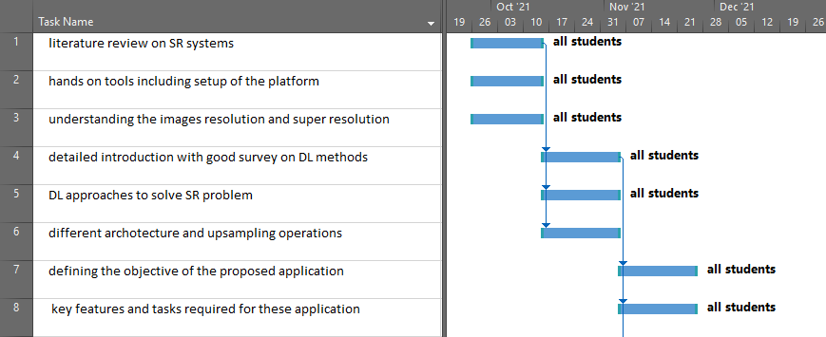
Planning

Slide 32
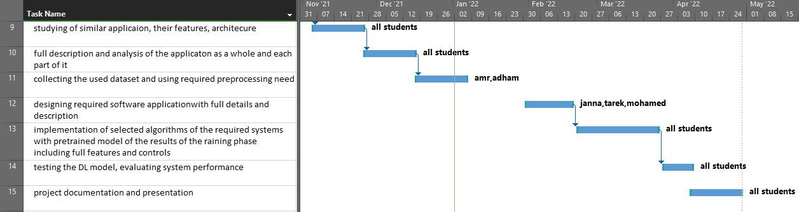
Planning

Slide 33
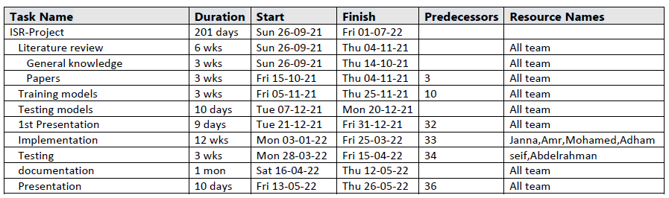
Planning

Slide 34

Planning

Slide 35
Literature review

Slide 36
Literature review
Many SISR methods have been studied long before and still used, such as bicubic which is based on interpolation.
Meanwhile, there are some widely used learning methods, such as nearest neighbor which assume that there exists a transformation between LR and HR patches.
Recently, deep learning (DL) has demonstrated better performance than traditional machine learning models in many artificial intelligence fields, including computer vision prompting the State-Of-The-Art.

Slide 37
Literature review
We will discuss the following deep learning models
SRCNN
Auto encoder
RDN
GAN
EDSR
As well as some lightweight models for SR:
Lightweight with MSAN
CNN-based lightweight neural networks
Slwrs

Slide 38
Interpolation based SISR
Nearest neighbor
Bicubic

Slide 39
1) Nearest neighbor
Nearest neighbor interpolation is the simplest type of interpolation
it is the quickest algorithm, but typically yields the poorest image quality.
the pixel we interpolate will have a value equal to the nearest known pixel value.
Computational Time Complexity of Image Interpolation Algorithms,
by Pankaj Parsania ,2018

Slide 40
1) Nearest neighbor
2.75
5.5
1
2
3
4
5
6
7
8
0
1
2
3
4
0
8
1
1
.
2
2x
2
3
2.25
3
4
.
4.5
4
5
4x4
Source Image
For example:
5.5/8*4=2.75
4.5/8*4=2.25
6
7
8
8x8
Destination Image
SourceCoord_x = (destinationCoord/destinationlength)*SourceLength
SourceCoord_y = (destinationCoord/destinationlength)*SourceLength
Computational Time Complexity of Image Interpolation Algorithms,by Pankaj Parsania ,2018

Slide 41
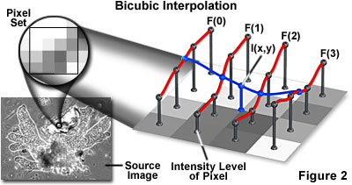
2) Bicubic Interpolation
One step beyond bilinear by considering the closest 4x4 neighborhood of known pixels, for a total of 16 pixels
Bicubic uses 3rd polynomial function (cubic function) which is continuous and smoothing function .
Good compromise between processing time and output quality.
Comparison of Commonly Used Image Interpolation Methods , Dianyuan Han , 2013

Slide 42
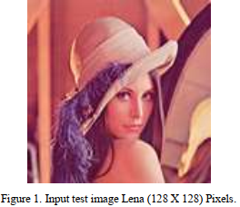
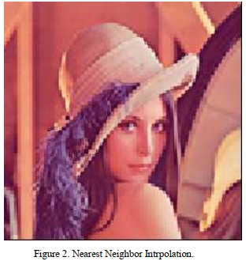

Nearest neighbor and Bicubic Interpolation
2x
2x
128x128
Input image
256x256
Nearest Neighbour
256x256
Bicubic Interpolation
Computational Time Complexity of Image Interpolation Algorithms,by Pankaj Parsania ,2018

Slide 43
Nearest neighbor and Bicubic Interpolation
Computational Time in seconds using Intel® Core i7 CPU @ 2.70 GHz and DDR3 RAM of 8 GB
Algorithms | 2x | 4x | 8x | 10x | 20x | 50x
Nearest Neighbour | 0.008 | 0.013 | 0.031 | 0.046 | 0.187 | 0.875
Bicubic | 0.028 | 0.078 | 0.359 | 0.562 | 2.203 | 13.853
Interpolation Algorithms | PSNR(dB) | Computation Time | Complexity of Algorithm | Computation
Nearest neighbour | 26.05 | Low | Low | Poor
Bicubic | 27.18 | Average | Average | good
Computational Time Complexity of Image Interpolation Algorithms,by Pankaj Parsania ,2018

Slide 44
Deep learning-based SR methods
SRCNN
Auto encoder
RDN
GAN
EDSR

Slide 45
1) SRCNN
While this task has traditionally been approached with non-neural methods such as bilinear and bicubic upsampling
This method directly learns an end-to-end mapping between the low/high-resolution images. The mapping is represented as a deep convolutional neural network (CNN) that takes the low-resolution image as the input and outputs the high-resolution one.
Unlike traditional methods that handle each component separately, our method jointly optimizes all layers.
Image Super-Resolution Using Deep Convolutional Networks
C Dong, C Loy, K He, X Tang, 2016

Slide 46
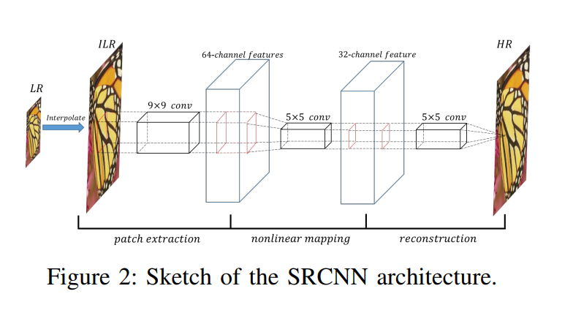
1) SRCNN
Image Super-Resolution Using Deep Convolutional Networks
C Dong, C Loy, K He, X Tang, 2016

Slide 47
1) SRCNN
The first layer: The input image with a 9x9 kernel with padding.
The second layer: expands the three-channel image into 64 feature maps, applies a 5x5 kernel to condense to 32 feature maps.
The third layer: applies a 5x5 kernel to generate the output image.
Image Super-Resolution Using Deep Convolutional Networks
C Dong, C Loy, K He, X Tang, 2016

Slide 48
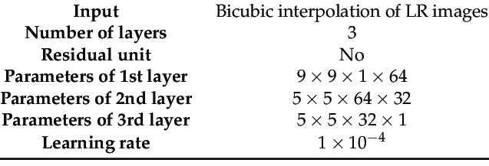
1) SRCNN
Parameters:

Slide 49
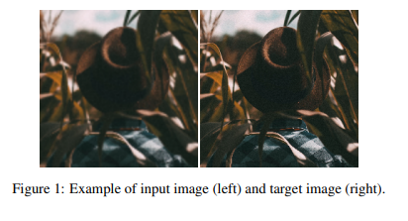
1) SRCNN
Image Super-Resolution Using Deep Convolutional Networks
C Dong, C Loy, K He, X Tang, 2016

Slide 50
2) Convolutional AutoEncoder
An autoencoder capable of encoding and decoding the structure of the images is proposed to enhance their resolution.
Image Resolution Enhancement Using Convolutional Autoencoders ,November 2020.

Slide 51
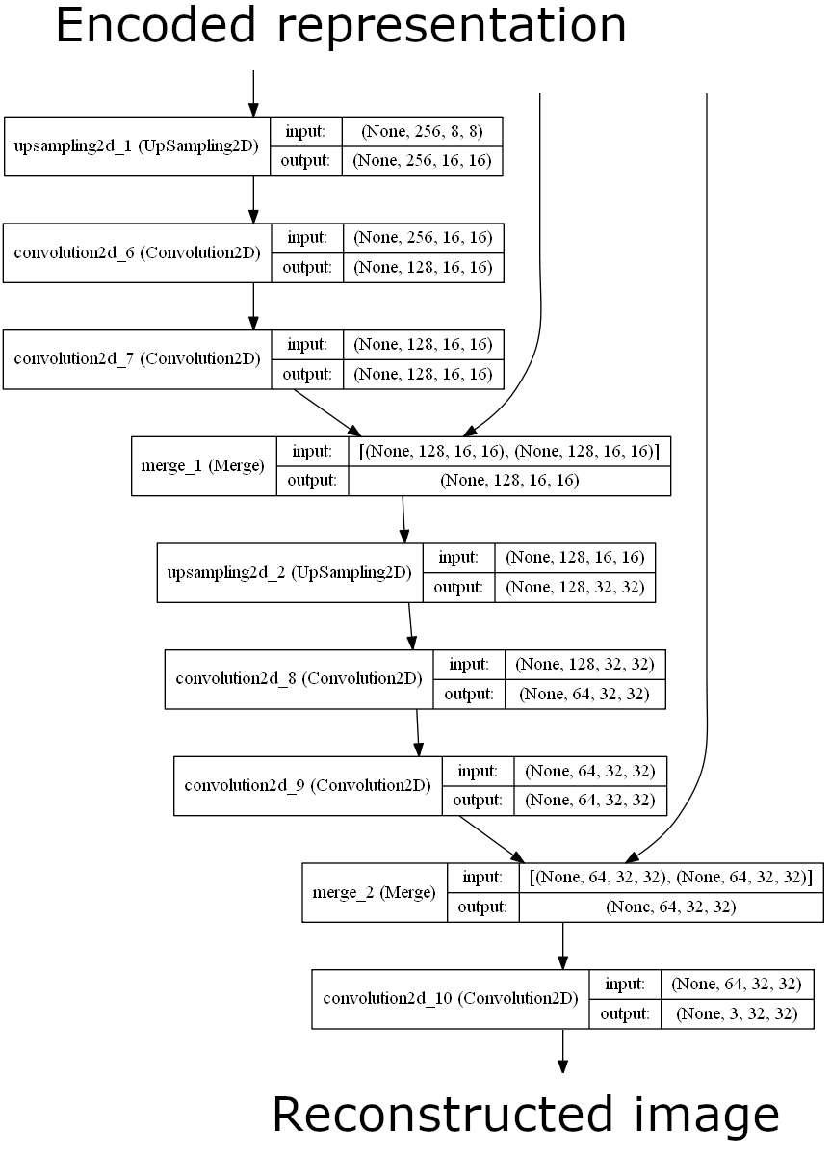
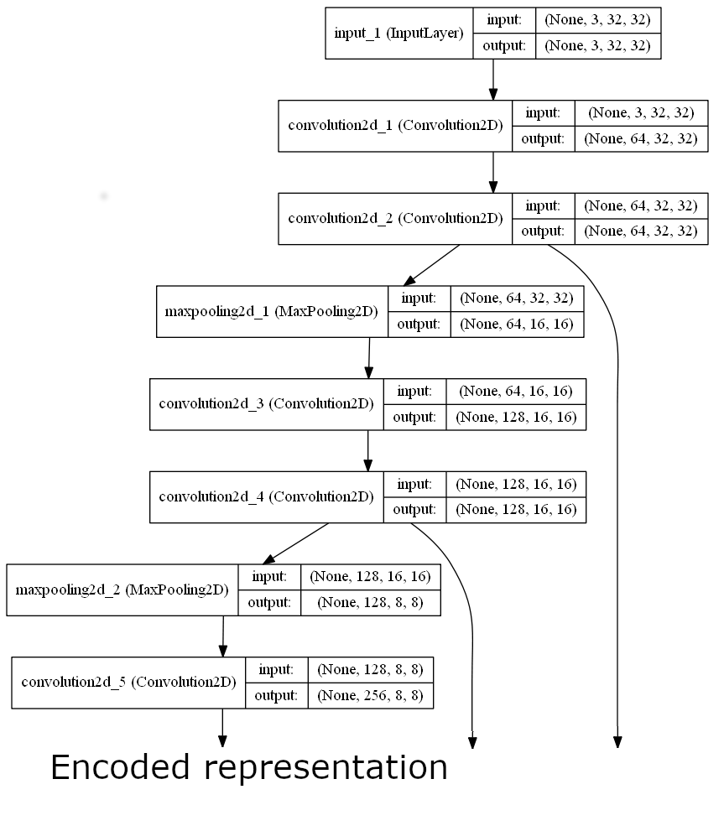
2) Convolutional AutoEncoder

Slide 52
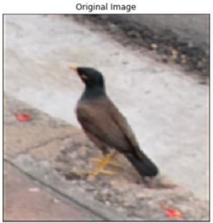
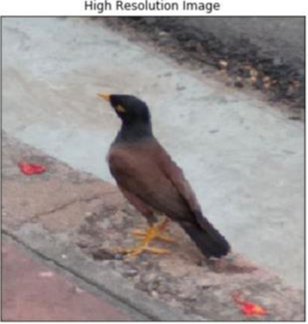
2) Convolutional Autoencoder
Image Resolution Enhancement Using Convolutional Autoencoders ,November 2020.

Slide 53
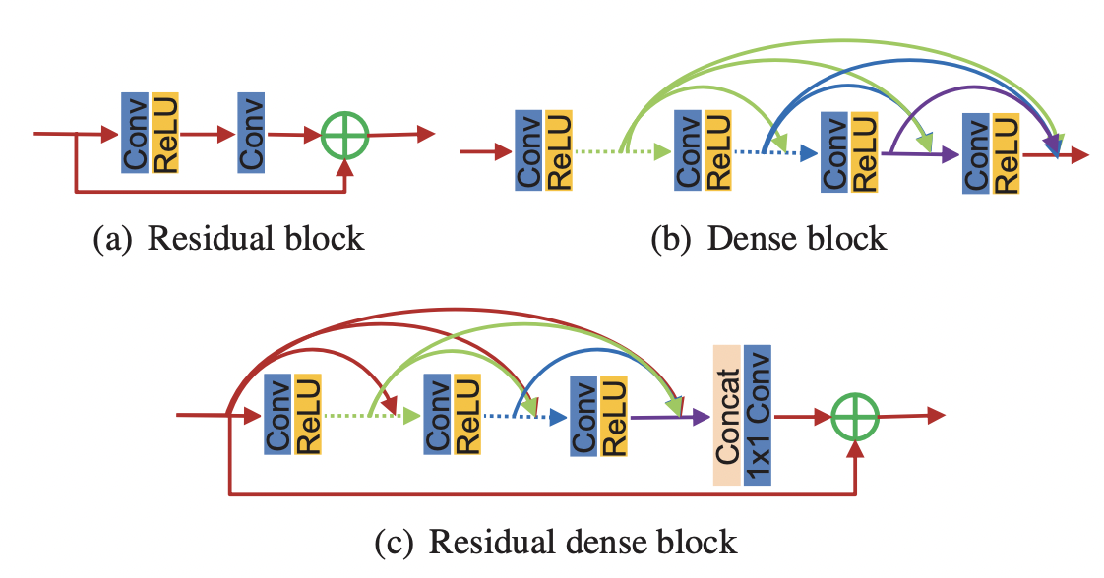




3) RDN
RDN Architecture
It’s combined with dense connection and residual learning, can make full use of hierarchical feature information from the original LR image with our proposed
residual dense block:
Residual Dense Network for Image Super-Resolution.
Zhang, Y., Tian, Y. and Kong, Y., 2018.

Slide 54

3) RDN
The solved problem
It’s hard and impractical for a very deep network to directly extract the output of each convolutional layer in the LR space.
so, for that propose residual dense block (RDB) as the building module for RDN.
RDB:
It’s can not only read state from the preceding RDB via a contiguous memory (CM) mechanism, but also fully utilize all the layers within it via local dense connections.
Residual Dense Network for Image Super-Resolution.
Zhang, Y., Tian, Y. and Kong, Y., 2018.

Slide 55
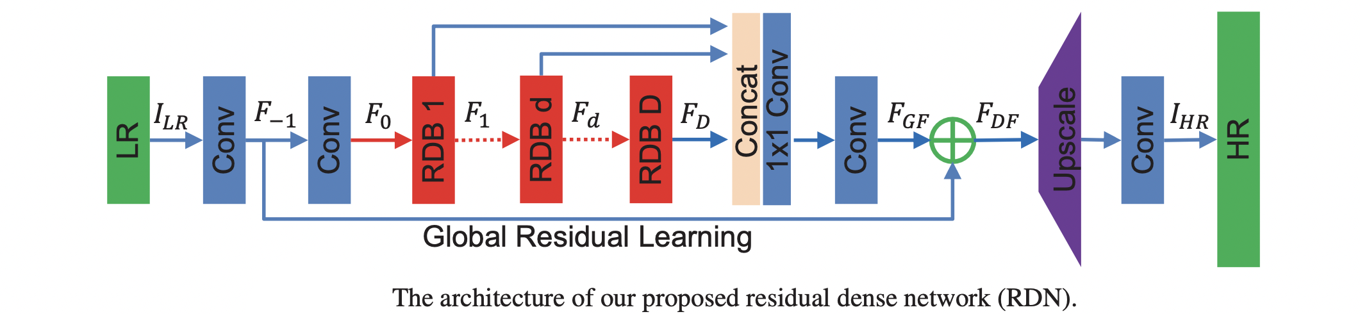
3) RDN
RDN Architecture:[12]
Residual Dense Network for Image Super-Resolution.
Zhang, Y., Tian, Y. and Kong, Y., 2018.

Slide 56
3) RDN
What make RDN unique
VDSR ,IRCNN , DRCN
All of these methods need to interpolate the original LR images to the desired size before applying them into the networks.
But this pre-processing step not only increases computation complexity , but also over-smooths and blurs the original LR image, from which some details are lost.
To solve the problem above, We directly took the original LR image as input and introduced a transposed convolution layer for upsampling to the fine resolution.
Residual Dense Network for Image Super-Resolution.
Zhang, Y., Tian, Y. and Kong, Y., 2018.

Slide 57
4) GAN(Generative Adversial Network)
Gan is the state of art
A generative adversarial network (GAN) is an especially effective type of generative model.
It was introduced in 10 Jun 2014.
Which has been a subject of intense interest in the machine learning community.
Powerful class of neural networks that are used for Unsupervised learning
A generative adversarial network (GAN) has two parts:
The generator learns to generate plausible data. The generated instances become negative training examples for the discriminator.
The discriminator learns to distinguish the generator's fake data from real data. The discriminator penalizes the generator for producing implausible results.

Slide 58
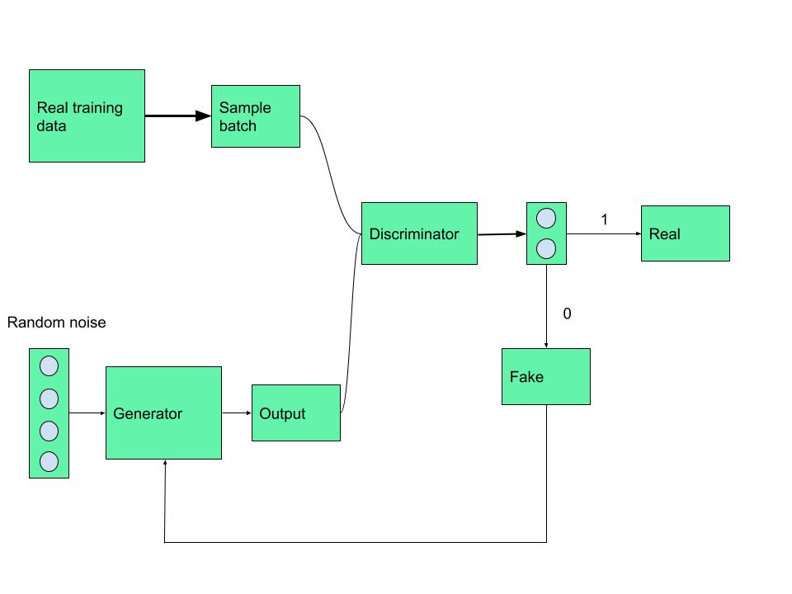

Slide 59
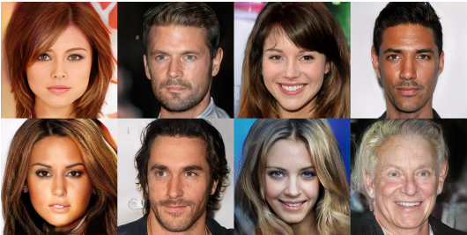
4) GAN
Generative adversarial networks (GANs) are an exciting recent innovation in machine learning. GANs are generative models: they create new data instances that resemble your training data. For example, GANs can create images that look like photographs of human faces, even though the faces don't belong to any real person. These images were created by a GAN as made by Images generated by a Gan made by NVIDIA

Slide 60
4) GAN
GANs achieve this level of realism by pairing a generator, which learns to produce the target output, with a discriminator, which learns to distinguish true data from the output of the generator. The generator tries to fool the discriminator, and the discriminator tries to keep from being fooled.
GAN Applications in SR Field
SRGAN(super resolution generative adversial network)
Perceptual GAN
SRPGAN
FCGAN
MCGAN
TEXTSR

Slide 61
4) Generator
Used to create realistic artificial data (Images in SR)
A Survey on Image Super-Resolution with Generative Adversarial Networks
H HÜSEM, Z ORMAN, 2021

Slide 62
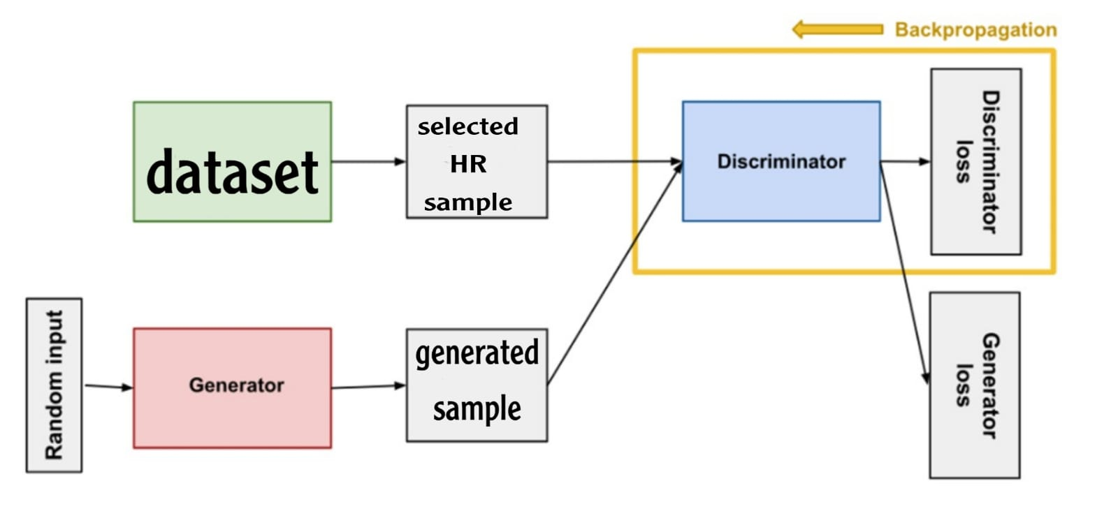
4) Discriminator
Aims to distinguish whether the data received is real or false
A Survey on Image Super-Resolution with Generative Adversarial Networks
H HÜSEM, Z ORMAN, 2021

Slide 63
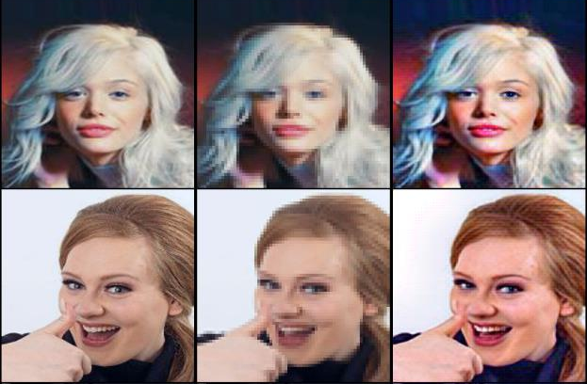
4) Experimental results
A Survey on Image Super-Resolution with Generative Adversarial Networks
H HÜSEM, Z ORMAN, 2021

Slide 64
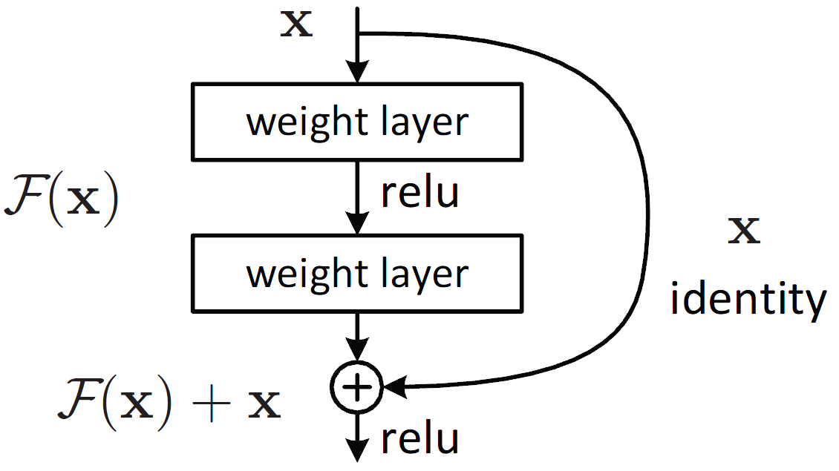
5) EDSR
Based on SRResNet architecture, EDSR is optimized by analyzing and removing unnecessary modules to simplify the network architecture
ResBlock architecture:

Slide 65
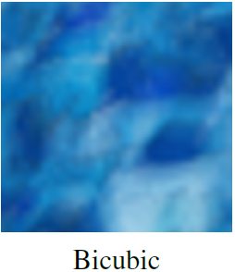
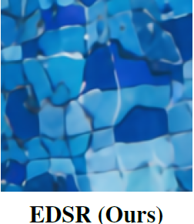
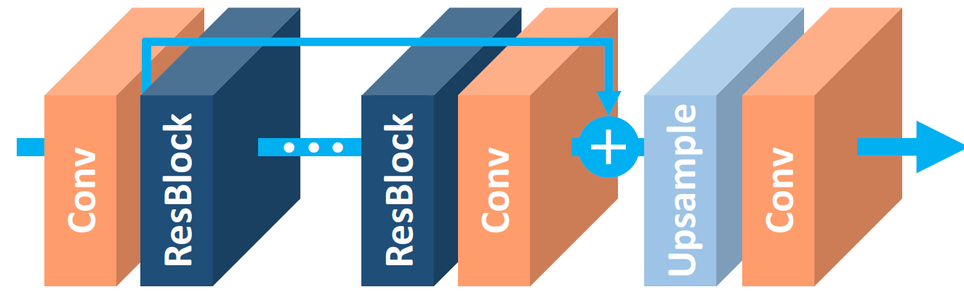

5) EDSR
EDSR Architecture:

Slide 66
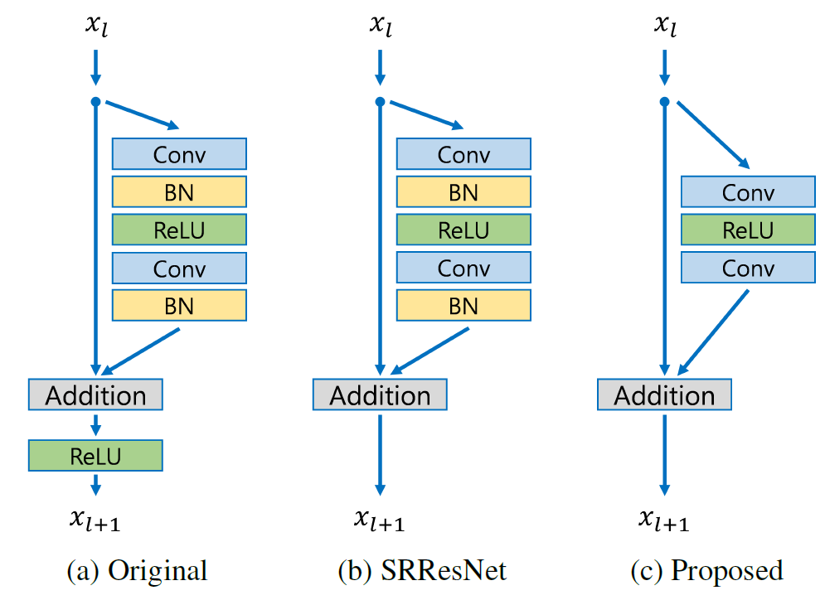
5) EDSR
What make EDSR unique
it Outperforms SRCNN, VDSR, SRResNet
There is no ReLU activation layers outside the residual blocks.
batch normalization is removed
Our baseline model without BN saves 40% of memory usage during training

Slide 67
Lightweight for SR
Lightweight with MSAN
CNN-based lightweight neural networks
Super lightweight super resolution

Slide 68
Lightweight for SR
Complicated deep neural network models have demonstrated better SR performance than traditional methods
But it is difficult to implement them on low complexity, low-power, and low-memory devices e.g. mobiles
Due to the massive network parameters and convolution operations of deeper and denser networks.

Slide 69
1) CNN-based lightweight neural networks
They propose two SR-based lightweight neural networks (LNNs) with:
- Inter-layered SR-LNN (SR-ILLNN)
- Simplified SR-LNN (SR-SLNN)
The proposed methods were designed to produce similar image quality while reducing the number of networks parameters
Single Image Super-Resolution Method Using CNN-Based Lightweight Neural Networks
S Kim, D Jun, B Kim, H Lee, E Rhee, 2021

Slide 70
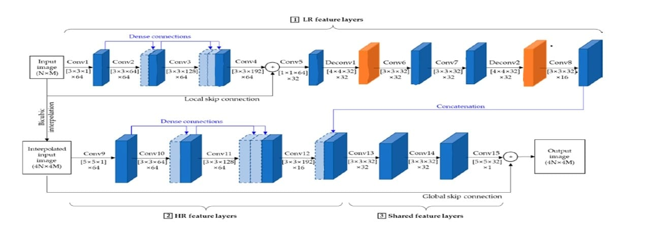
Architecture of SR-ILLNN
It consists of three parts, which are LR feature layers from convolutional layer 1 (Conv1) to Conv8, HR feature layers from Conv9 to Conv12, and shared feature layers from Conv13 to Conv15
Single Image Super-Resolution Method Using CNN-Based Lightweight Neural Networks
S Kim, D Jun, B Kim, H Lee, E Rhee, 2021

Slide 71
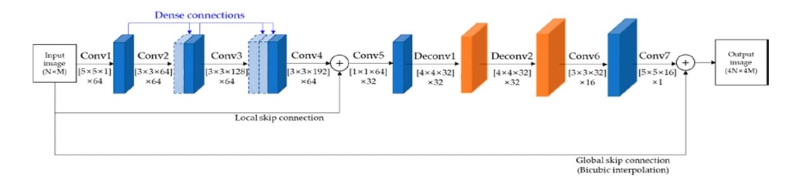
Architecture of SR-SLNN
To reduce the network complexity of SR-ILLNN.
HR feature layers, shared feature layers, and two convolution layers between deconvolution layers of SR-ILLNN are removed.
It has seven convolution layers and two deconvolution layers.
Single Image Super-Resolution Method Using CNN-Based Lightweight Neural Networks
S Kim, D Jun, B Kim, H Lee, E Rhee, 2021

Slide 72
2) Lightweight SISR With Multi-Scale Spatial Attention Networks
They propose Multi-scale Spatial Attention Networks (MSAN) that can adaptively give attention to the most appropriate scale of features in a specific region of the image.
They designed a Multi-scale Spatial Attention Block (MSAB) as a basic building block for the MSAN.
Lightweight Single Image Super-Resolution With Multi-Scale Spatial Attention Networks
J Soh, N Cho, 2020

Slide 73
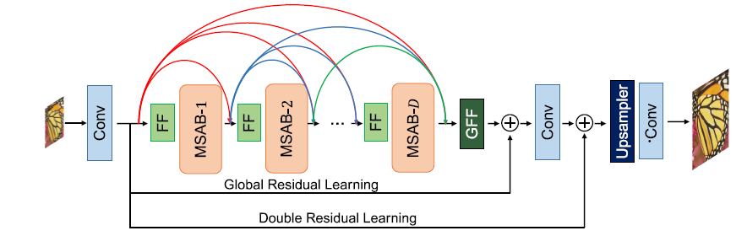
Architecture of MSAN
It can be divided into three functional parts: feature extractor, feature enhancer, and reconstructor.[9]
Lightweight Single Image Super-Resolution With Multi-Scale Spatial Attention Networks
J Soh, N Cho, 2020

Slide 74
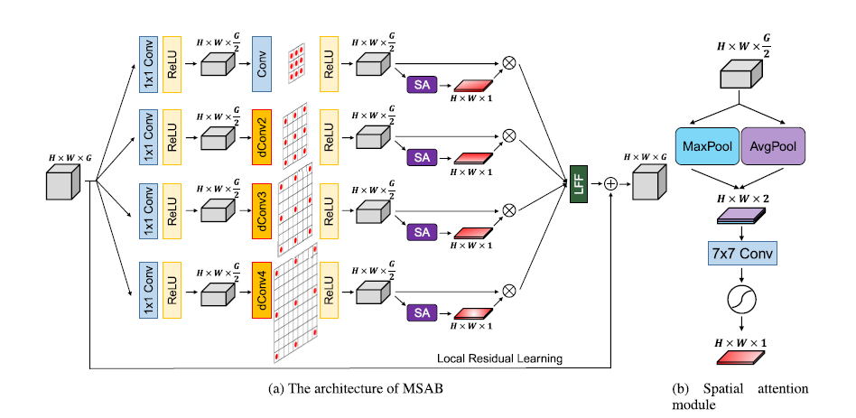
Architecture of MSAB
Extract dynamic multi-scale features via local residual learning and spatial attention.[9]
Lightweight Single Image Super-Resolution With Multi-Scale Spatial Attention Networks
J Soh, N Cho, 2020
Notes:
Relu compress the input features for each branch, featires of each branch are fed to the dilated convolution layers with diff dialation rates.. Then relu activation function.
Dialated con layer provides various sizes of receptive fields without inceasing number of parameters
The features are fed to the spatial attention module to generate the spatial attention map, so that the features are furthered rescaled by spatial attention map to get “attention applied feature”

Slide 75
3) Super lightweight SR network
Technical details of SLWSR
Basic Residual Blocks
Symmetric Connection Frame
Information Pool
Model Compression
Activation Removal Mechanism
s-LWSR: Super Lightweight Super-Resolution Network
B Li, B Wang, J Liu, Z Qi, Y Shi, 2020
Notes:
they build the information pool to transmit features to high-dimensional channels, enforces better features transmission between the first and the second half of the model

Slide 76
3) Super lightweight SR network
Basic Residual Blocks:
Fundamental unit used to sufficiently extract information from the LR image
Symmetric Connection Frame and Information Pool:
The backbone of the network, functioning as the fusion of multi-level information among intermediate layers
s-LWSR: Super Lightweight Super-Resolution Network
B Li, B Wang, J Liu, Z Qi, Y Shi, 2020

Slide 77
3) Super lightweight SR network
Model Compression:
Decrease the number of parameters and operations, so that the model size can be controlled within an ideal range.
Activation Removal Mechanism:
Selected activation layers are removed from the pipeline to retain more information in inner layers.
s-LWSR: Super Lightweight Super-Resolution Network
B Li, B Wang, J Liu, Z Qi, Y Shi, 2020
Notes:
When performing the non-linear mapping in some activation layers, useful information is likely to be partly discarded.

Slide 78
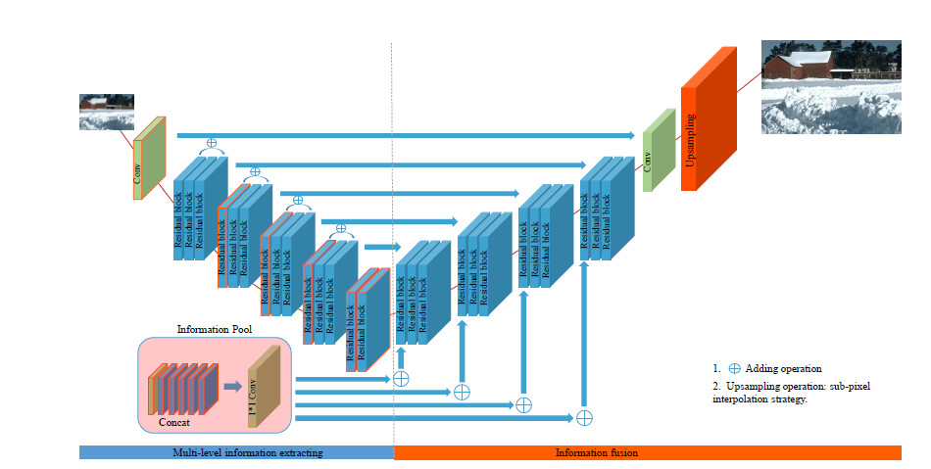
Architecture of MSAN
It can be divided into three functional parts: feature extractor, feature enhancer, and reconstructor.
Notes:
The architecture of s-LWSR. The blue one is the basic residual block with all chosen blocks for information pool marked in red. Convolutional layers
appear in green color. The information pool and the path of information are also marked with arrow lines.
The first five LBs serve as the multi-level information extractor for the information pool, and rest blocks are information fusion part.
They further introduce local residual learning (LRL) to fuse features from different dimension

Slide 79
Experimental Results

Slide 80
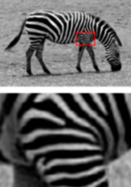
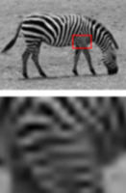
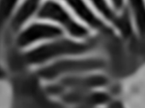
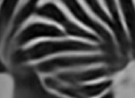

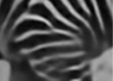
Results
(PSNR/SSIM)
(24.18dB/0.6834)
(26.20dB/0.7535)
 | Original | Bicubic | SRCNN
 | Densenet | SR-ILLNN | SR-SLNN
(26.73dB/0.7675)
(26.81dB/0.7692)
(26.71dB/0.7670)

Slide 81
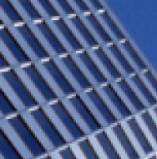


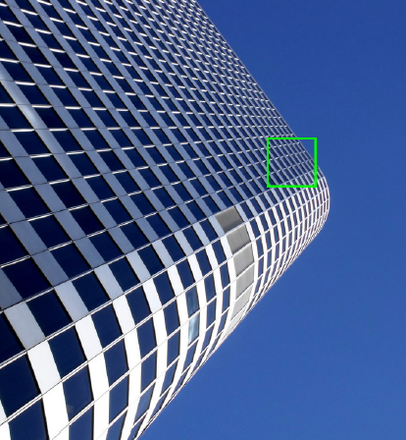

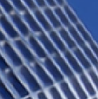

Results
(PSNR/SSIM)
(26.88dB/0.8403)
(29.50dB/0.8946)
 | Original | Bicubic | SRCNN
 | VDSR | MSAN | MSAN-X
(30.76dB/0.9140)
(32.37dB/0.9298)
(31.91dB/0.9255)

Slide 82
Results
Methods | Parameters
SRCNN | 57K
EDSR | 43.1M
RDN | 22.3M
RCAN | 15.6M
MSAN | 1827K
MSAN-X | 1018K
SR-ILLNN | 439K
SR-SLNN | 262K
SLWRS | 140K

Slide 83
Measures of Quality image

Slide 84
Measures of Quality image
Image Quality assessment
Subjective methods
Objective methods

Slide 85
Subjective methods
In subjective testing a group of people are asked to give their opinion about the quality of each image.
Types:
Mean opinion score (MOS)
Ordering by force-choice pair-wise comparison

Slide 86
Objective methods
The No reference metrics focus on the assessment of the quality of a test image only. No reference image is used in this method.
The Full reference approaches focus on the assessment of the quality of a test image in comparison with a reference image.

Slide 87
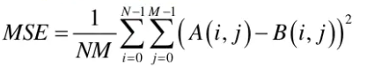
MSE (Mean Square Error)
The difference between the Pixel value of one image and the corresponding Pixel value of the other image.
The MSE measures the average of the square of the errors

Slide 88
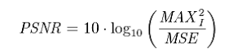
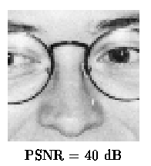
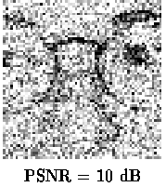
PSNR (Peak Signal to Noise Ratio)
PSNR is used to calculate the ratio between the maximum possible signal power and the power of the distorting noise
MSNR | PSNR
High | Low
0 | High

Slide 89
Structure Similarity Index Method (SSIM)
It measures the similarity between two images.
Structural Similarity Index Method can be expressed through these three terms as:
l is the luminance (used to compare the brightness between two images)
c is the contrast (used to differ the ranges between the brightest and darkest region of two images)
s is the structure (used to compare the local luminance pattern between two images to find the similarity of the images) and α, β and γ are the positive constants.

Slide 90
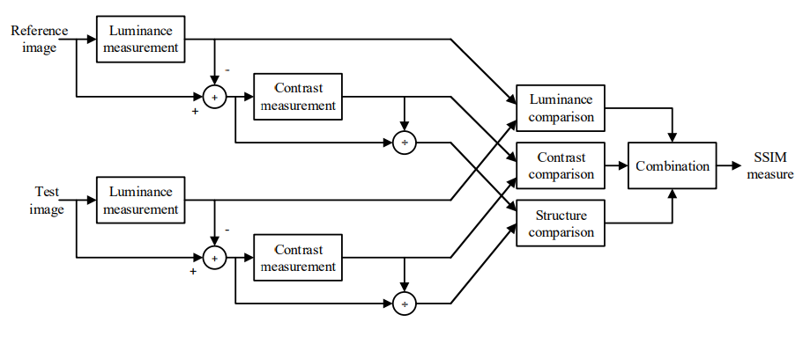

SSIM

Slide 91
Methodology

Slide 92

Methodology

Slide 93
Datasets

Slide 94
Datasets
Name | DIV2K
Structure | 1000 images. Extension: .PNG
Details | Size: 13.1 GB 8,510 Files,18 Folders
Folders | Images dimensions range from
LR test and train | X2: width( 678 → 1020 ), height(462 →1020 ) X3: width( 452 → 680 ), height( 332 → 680 ) X4: width( 339 → 510 ), height( 231 → 210 )
HR train | width( 1284→ 2040 ), height(732→ 2040 )

Slide 95
Tools

Slide 96



Tools
Environment
Programming Language
Libraries
Python 3.x.x
TensorFlow
Pytorch

Slide 97

Thank you

